Slide 1
디지털경제와 경영전략
Data Modeling & Basics of Process Modeling

Slide 2
Agenda
Data Modeling
  Conceptual Modeling: Entity Relationship Diagram
  Physical Modeling: Table, Normalization
Basics of Process Modeling
  Data Flow Diagram: Definition, Concept, Components

Slide 3
Data Modeling

Slide 4
Conceptual Data Modeling
Representation of organizational data
Purpose is to show rules about the meaning and interrelationships among data
Entity-Relationship (E-R) diagrams are commonly used to show how data are organized
Main goal of conceptual data modeling is to create accurate E-R diagrams
Methods such as interviewing, questionnaires and JAD are used to collect information
Consistency must be maintained between process flow, decision logic and data modeling descriptions
10.<number>

Slide 5
Process of Conceptual Data Modeling
First step is to develop a data model for the system being replaced
Next, a new conceptual data model is built that includes all the requirements of the new system
In the design stage, the conceptual data model is translated into a physical design
Project repository links all design and data modeling steps performed during SDLC
10.<number>

Slide 6
Deliverables and Outcome
Primary deliverable is the entity-relationship diagram
There may be as many as 4 E-R diagrams produced and analyzed during conceptual data modeling
  Covers just data needed in the project’s application
  E-R diagram for system being replaced
  An E-R diagram for the whole database from which the new application’s data are extracted
  An E-R diagram for the whole database from which data for the application system being replaced is drawn
10.<number>

Slide 7
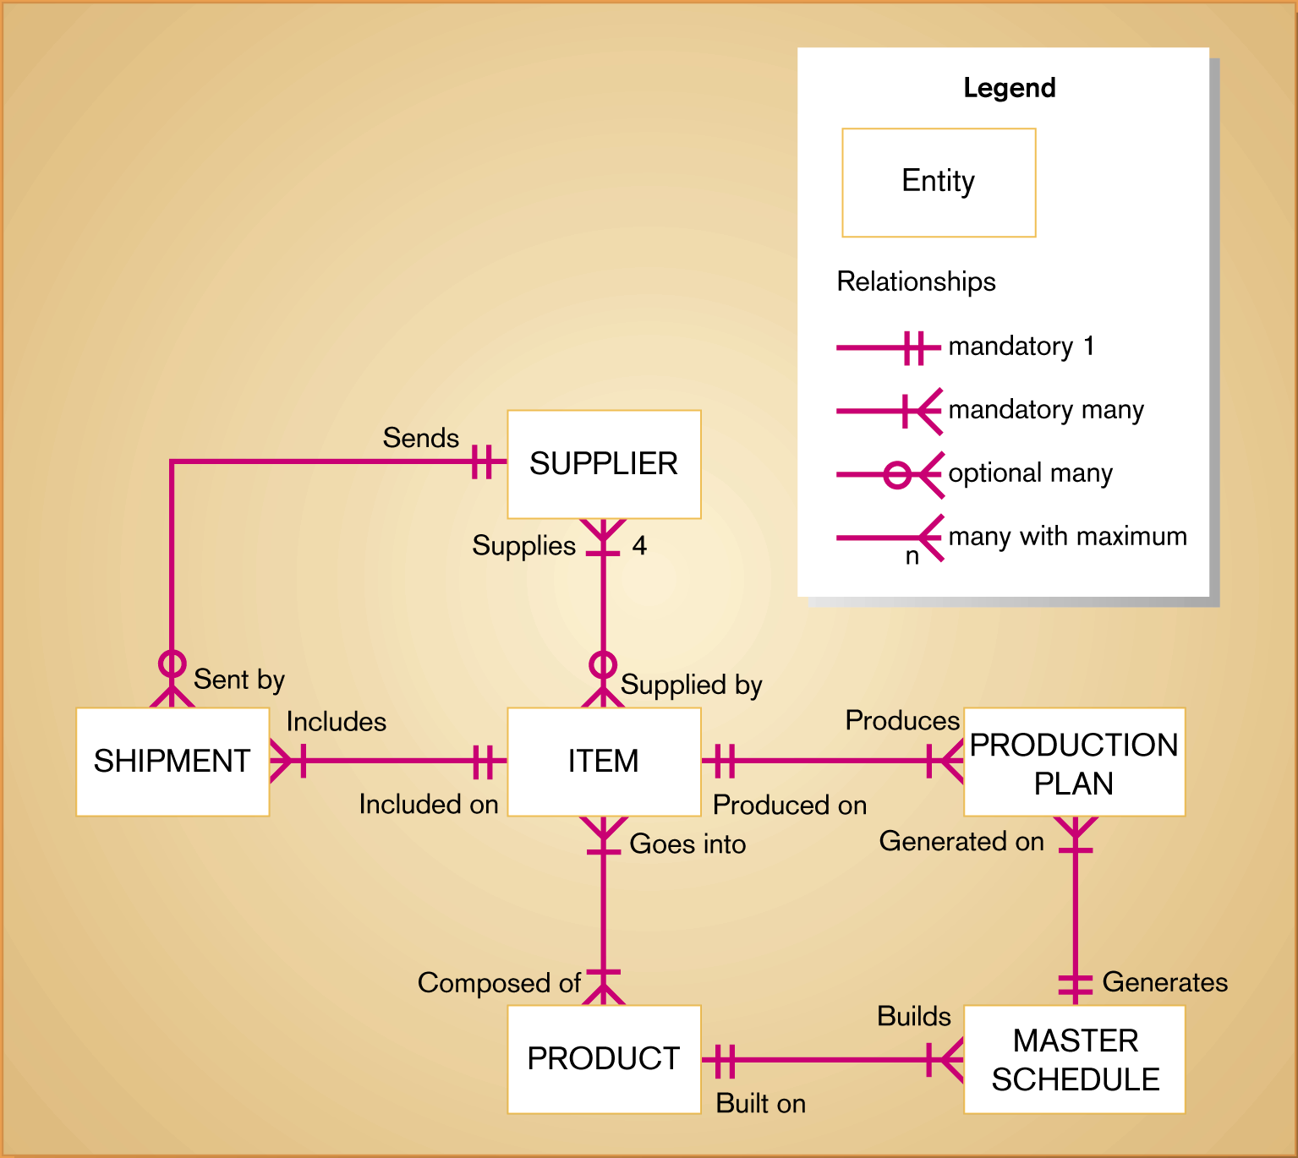
Figure 10-3
Sample conceptual data model diagram
10.<number>

Slide 8
Deliverables and Outcome
Second deliverable is a set of entries about data objects to be stored in repository or project dictionary
  Repository links data, process and logic models of an information system
  Data elements that are included in the DFD must appear in the data model and visa versa
  Each data store in a process model must relate to business objects represented in the data model
10.<number>

Slide 9
Gathering Information for Conceptual Data Modeling
Two perspectives
  Top-down
    Data model is derived from an intimate understanding of the business
  Bottom-up
    Data model is derived by reviewing specifications and business documents
10.<number>

Slide 10
Introduction to Entity-Relationship (E-R) Modeling
Notation uses three main constructs
  Data entities
  Relationships
  Attributes
Entity-Relationship (E-R) Diagram
  A detailed, logical representation of the entities, associations and data elements for an organization or business
10.<number>

Slide 11
Entity-Relationship (E-R) Modeling
Key Terms
Entity
  A person, place, object, event or concept in the user environment about which the organization wishes to maintain data
  Represented by a rectangle in E-R diagrams
Entity Type
  A collection of entities that share common properties or characteristics
Attribute
  A named property or characteristic of an entity that is of interest to an organization
10.<number>

Slide 12
Entity-Relationship (E-R) Modeling
Key Terms
Candidate keys and identifiers
  Each entity type must have an attribute or set of attributes that distinguishes one instance from other instances of the same type
  Candidate key
    Attribute (or combination of attributes) that uniquely identifies each instance of an entity type
10.<number>

Slide 13
Entity-Relationship (E-R) Modeling
Key Terms
Identifier
  A candidate key that has been selected as the unique identifying characteristic for an entity type
  Selection rules for an identifier
    Choose a candidate key that will not change its value
    Choose a candidate key that will never be null
    Avoid using intelligent keys
    Consider substituting single value surrogate keys for large composite keys
10.<number>

Slide 14
Entity-Relationship (E-R) Modeling
Key Terms
Relationship
  An association between the instances of one or more entity types that is of interest to the organization
  Association indicates that an event has occurred or that there is a natural link between entity types
  Relationships are always labeled with verb phrases
10.<number>

Slide 15
Conceptual Data Modeling and the E-R Diagram
Goal
  Capture as much of the meaning of the data as possible
Result
  A better design that is easier to maintain
10.<number>

Slide 16
Domains
The set of all data types and ranges of values that an attribute can assume
Several advantages
  Verify that the values for an attribute are valid
  Ensure that various data manipulation operations are logical
  Help conserve effort in describing attribute characteristics
10.<number>

Slide 17
The Role of CASE in Conceptual Data
CASE tools provide two important functions:
  Maintain E-R diagrams as a visual depiction of structured data requirements
  Link objects on E-R diagrams to corresponding descriptions in a repository
10.<number>

Slide 18
Purpose of Database Design
Structure the data in stable structures, called normalized tables
  Not likely to change over time
  Minimal redundancy
Develop a logical database design that reflects actual data requirements
Develop a logical database design from which a physical database design can be developed
12.<number>

Slide 19
Purpose of Database Design
Translate a relational database model into a technical file and database design that balances several performance factors
Choose data storage technologies that will efficiently, accurately and securely process database activities
12.<number>

Slide 20
Process of Database Design
Logical Design
  Based upon the conceptual data model
  Four key steps
    Develop a logical data model for each known user interface for the application using normalization principles
    Combine normalized data requirements from all user interfaces into one consolidated logical database model
    Translate the conceptual E-R data model for the application into normalized data requirements
    Compare the consolidated logical database design with the translated E-R model and produce one final logical database model for the application
12.<number>

Slide 21
Process of Database Design
Physical Design
  Based upon results of logical database design
  Key decisions
    Choosing storage format for each attribute from the logical database model
    Grouping attributes from the logical database model into physical records
    Arranging related records in secondary memory (hard disks and magnetic tapes) so that records can be stored, retrieved and updated rapidly
    Selecting media and structures for storing data to make access more efficient
12.<number>

Slide 22
Deliverables and Outcomes
Logical database design must account for every data element on a system input or output
Normalized relations are the primary deliverable
Physical database design results in converting relations into files
12.<number>

Slide 23
Relational Database Model
Data represented as a set of related tables or relations
Relation
  A named, two-dimensional table of data. Each relation consists of a set of named columns and an arbitrary number of unnamed rows
  Properties
    Entries in cells are simple
    Entries in columns are from the same set of values
    Each row is unique
    The sequence of columns can be interchanged without changing the meaning or use of the relation
    The rows may be interchanged or stored in any sequence
12.<number>

Slide 24
Relational Database Model
Well-Structured Relation
  A relation that contains a minimum amount of redundancy and allows users to insert, modify and delete the rows without errors or inconsistencies
12.<number>

Slide 25
Normalization
The process of converting complex data structures into simple, stable data structures
Second Normal Form (2NF)
  Each nonprimary key attribute is identified by the whole key (called full functional dependency)
12.<number>

Slide 26
Normalization
Third Normal Form (3NF)
  Nonprimary key attributes do not depend on each other (called transitive dependencies)
The result of normalization is that every nonprimary key attribute depends upon the whole primary key
12.<number>

Slide 27
Functional Dependencies and Primary Keys
Functional Dependency
  A particular relationship between two attributes. For a given relation, attribute B is functionally dependent on attribute A is, for every valid value of A, that value of A uniquely determines the value of B
  Instances (or sample data) in a relation do not prove the existence of a functional dependency
  Knowledge of problem domain is most reliable method for identifying functional dependency
Primary Key
  An attribute whose value is unique across all occurrences of a relation
12.<number>

Slide 28
Functional Dependencies and Primary Keys
Second Normal Form (2NF)
  A relation is in second normal form (2NF) if any of the following conditions apply:
    The primary key consists of only one attribute
    No nonprimary key attributes exist in the relation
    Every nonprimary key attribute is functionally dependent on the full set of primary key attributes
12.<number>

Slide 29
Functional Dependencies and
Primary Keys
Conversion to second normal form (2NF)
  To convert a relation into 2NF, decompose the relation into new relations using the attributes, called determinants, that determine other attributes
  The determinants become the primary key of the new relation
12.<number>

Slide 30
Functional Dependencies and
Primary Keys
Third Normal Form (3NF)
  A relation is in third normal form (3NF) if it is in second normal form (2NF) and there are no functional (transitive) dependencies between two (or more) nonprimary key attributes
12.<number>

Slide 31
Functional Dependencies and
Primary Keys
Foreign Key
  An attribute that appears as a nonprimary key attribute in one relation and as a primary key attribute (or part of a primary key) in another relation
Referential Integrity
  An integrity constraint specifying that the value (or existence) of an attribute in one relation depends on the value (or existence) of the same attribute in another relation
12.<number>

Slide 32
Transforming E-R Diagrams into Relations
It is useful to transform the conceptual data model into a set of normalized relations
Steps
  Represent entities
  Represent relationships
  Normalize the relations
  Merge the relations
12.<number>

Slide 33
Transforming E-R Diagrams into Relations
Represent Entities
  Each regular entity is transformed into a relation
  The identifier of the entity type becomes the primary key of the corresponding relation
  The primary key must satisfy the following two conditions
    The value of the key must uniquely identify every row in the relation
    The key should be nonredundant
12.<number>

Slide 34
Transforming E-R Diagrams into Relations
Represent Relationships
  Binary 1:N Relationships
    Add the primary key attribute (or attributes) of the entity on the one side of the relationship as a foreign key in the relation on the right side
    The one side migrates to the many side
  Binary or Unary 1:1
    Three possible options
      Add the primary key of A as a foreign key of B
      Add the primary key of B as a foreign key of A
      Both of the above
12.<number>

Slide 35
Transforming E-R Diagrams into Relations
Represent Relationships (continued)
  Binary and Higher M:N relationships
    Create another relation and include primary keys of all relations as primary key of new relation
  Unary 1:N Relationships
    Relationship between instances of a single entity type
    Utilize a recursive foreign key
      A foreign key in a relation that references the primary key values of that same relation
  Unary M:N Relationships
    Create a separate relation
    Primary key of new relation is a composite of two attributes that both take their values from the same primary key
12.<number>

Slide 36
Physical File and Database Design
The following information is required
  Normalized relations, including volume estimates
  Definitions of each attribute
  Descriptions of where and when data are used, entered, retrieved, deleted and updated (including frequencies)
  Expectations or requirements for response time and data integrity
  Descriptions of the technologies used for implementing the files and database
12.<number>

Slide 37
Designing Fields
Field
  The smallest unit of named application data recognized by system software
  Each attribute from each relation will be represented as one or more fields
Choosing data types
  Data Type
    A coding scheme recognized by system software for representing organizational data
  Four objectives
    Minimize storage space
    Represent all possible values of the field
    Improve data integrity of the field
    Support all data manipulations desired on the field
  Calculated fields
    A field that can be derived from other database fields
12.<number>

Slide 38
Designing Physical Tables
Relational database is a set of related tables
Physical Table
  A named set of rows and columns that specifies the fields in each row of the table
Design Goals
  Efficient use of secondary storage (disk space)
    Disks are divided into units that can be read in one machine operation
    Space is used most efficiently when the physical length of a table row divides close to evenly with storage unit
  Efficient data processing
    Data are most efficiently processed when stored next to each other in secondary memory
12.<number>

Slide 39
Designing Physical Tables
Denormalization
  The process of splitting or combining normalized relations into physical tables based on affinity of use of rows and fields
  Partitioning
    Capability to split a table into separate sections
    Oracle 8i implements three types
      Range
      Hash
      Composite
  Optimizes certain operations at the expense of others
12.<number>

Slide 40
Designing Physical Tables
Denormalization
  Three common situations where denormalization may be used
    Two entities with a one-to-one relationship
    A many-to-many relationship with nonkey attributes
    Reference data
12.<number>

Slide 41
Basics of Process Modeling

Slide 42
Designing Info Systems
Decompose a complex system into pieces, develop a solution for each piece and integrate the pieces
2 Systems development methodologies-
  Traditional Systems Development (Yourdon; DeMarco; and Martin)
  Object Oriented Systems Development (Booch; Coad and Yourdon; Martin and Odell; Rumbaugh; Schaler and Mellor)

Slide 43
Systems Modeling
Enterprise Model graphically represents organizational entities and the relationships between entities
A process model represents a system’s functions (data flow diagrams)
A data model represents a system’s data and the relationships between data elements (entity relationship diagram)
An object model represents a system’s classes including attributes, methods and relationships

Slide 44
Process Modeling
Graphically represent the processes that capture, manipulate, store and distribute data between a system and its environment and among system components
Data flow diagrams (DFD)
  Graphically illustrate movement of data between external entities and the processes and data stores within a system
8.<number>

Slide 45
Process Modeling
Deliverables and outcomes (continued)
  Context data flow diagram (DFD)
    Scope of system
  DFDs of current system
    Enables analysts to understand current system
  DFDs of new logical system
    Technology independent
    Show data flows, structure and functional requirements of new system
8.<number>

Slide 46
Pizza Delivery Example
4. confirmation
Customer
1. Coupon, order
address
payment type
Sales
2. wait time
3. order details
10. Pizza
Database
5. order
11. Payment
7. address
Chef
9. Pizza collected
6. order done
12. Payment received
Delivery
8. Pizza

Slide 47
Doors-R-Us Service Example
Process:
Materials
Manager
8.
Work
Order
Dispatcher
Accounts
Receivable
Clerk
9.
Installer
10.
7.
6.
11.
Receptionist
Bill
2.
Customer
5.
1.
3.
Salespeople
4.
Quote
Estimator

Slide 48
Doors-R-Us Process Explanation
1. Salespeople get potential customers familiar with company/services
2. When potential customer needs a door service, they call HQ, get the receptionist
3. Receptionist finds estimator (HQ /road) to visit customer and assess situation
4. Estimator inspects site and submits quote to warehouse manager
5. If customer decides to use Doors-R-Us, calls HQ (receptionist) to request service
6. Receptionist finds dispatcher to schedule the work
7. Dispatcher and customer agree on time for service

Slide 49
Doors-R-Us Process Explanation
8. Dispatcher gets needed supplies from Materials Manager
9. Dispatcher sends an installer to get the replacement door and install it
10. Installer writes up a work order and submits to A/R Clerk
11. A/R Clerk sends bill to Customer

Slide 50
Data Flow Diagram
EE1
External Entity
Name
D1
Data store
1.1
System process
description
Data Flow
Gane and Sarson Symbols

Slide 51
Data Flow Diagramming Mechanics
Data Flow
  Depicts data that are in motion and moving as a unit from one place to another in the system.
  Drawn as an arrow
  Select a meaningful name to represent the data
8.<number>

Slide 52
Data Flow Diagramming Mechanics
Data Store
  Depicts data at rest
  May represent data in
    File folder
    Computer-based file
    Notebook
  The name of the store as well as the number are recorded in between lines
8.<number>

Slide 53
Data Flow Diagramming Mechanics
Process
  Depicts work or action performed on data so that they are transformed, stored or distributed
  Number of process as well as name are recorded
8.<number>

Slide 54
Data Flow Diagramming Mechanics
Source/Sink
  Depicts the origin and/or destination of the data
  Sometimes referred to as an external entity
  Drawn as a square symbol
  Name states what the external agent is
  Because they are external, many characteristics are not of interest to us
8.<number>

Slide 55
Data Flow Diagramming Definitions
Context Diagram
  A data flow diagram (DFD) of the scope of an organizational system that shows the system boundaries, external entities that interact with the system and the major information flows between the entities and the system
Level-O Diagram
  A data flow diagram (DFD) that represents a system’s major processes, data flows and data stores at a high level of detail
8.<number>

Slide 56
Developing DFDs: An Example
Hoosier Burger’s automated food ordering system
Context Diagram (Figure 8-4) contains no data stores
Next step is to expand the context diagram to show the breakdown of processes (Figure 8-5)
8.<number>

Slide 57
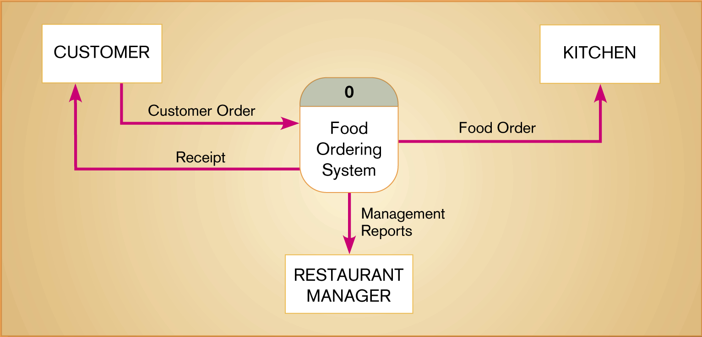
Figure 8-4
Context diagram of Hoosier Burger’s food ordering system
8.<number>

Slide 58
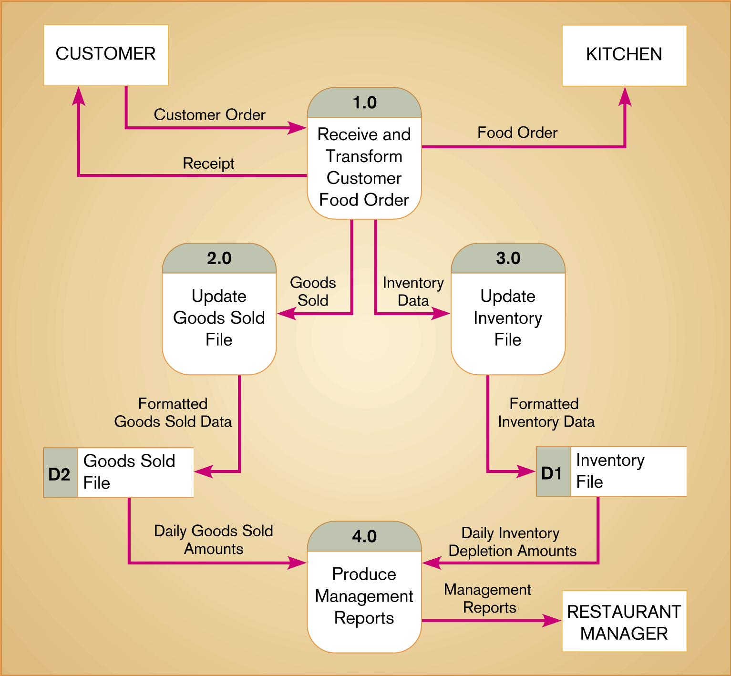
Figure 8-5
Level-0 DFD of Hoosier Burger’s food ordering system
8.<number>

Slide 59
Next Lecture on 23rd April
Lecture: Process Modeling (Cont’d)
Homework 2 (Team Feasibility & Requirement Analysis) & Chapter 10 Multiple Choices graded Due
Find 6 categories of feasibility, requirements of the department & information system from the script

